Slide 1

Probabilistic Model Checking
Marta Kwiatkowska
Gethin Norman
Dave Parker
University of Oxford
Part 8 - PTA Case Studies

Slide 2
Overview
Discuss two real-world protocol examples
  modelled as probabilistic timed automata
  quantitatively analysed with PRISM
  compare experimental results (digital clocks, symbolic, sampling-based)
IEEE 1394 FireWire root contention
  randomised leader election protocol, widely used
  confirmed a peculiarity…
IEEE 802.3 CSMA/CD
  distributed network arbitration protocol
  uses random backoff scheme, typical of Medium Access Control protocols

Slide 3

IEEE 1394 (FireWire) root contention
Serial bus for networking multimedia devices
  "hot-pluggable" - add/remove devices (nodes) at any time
Root contention protocol
  leader election algorithm, when nodes join/leave
  nodes send messages: "be my parent"
  root contention: when nodes contend leadership
  random choice: "fast"/"slow" delay before retry
Properties of interest
  time taken for leader election
  effect of using biased coin
  conjecture [Sto02]

Slide 4
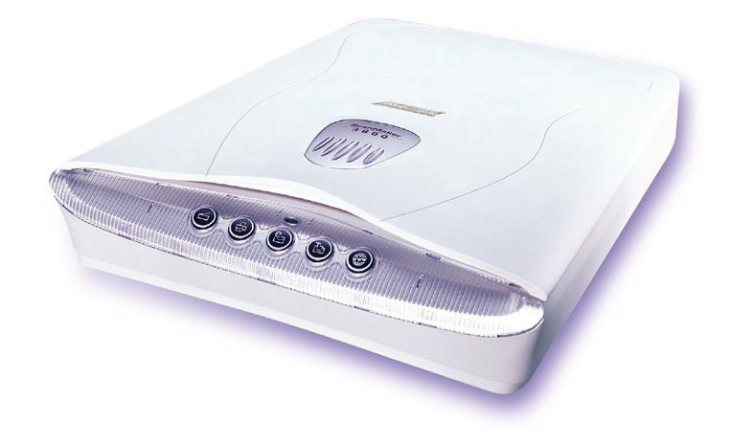

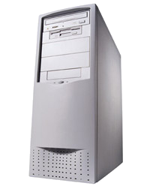
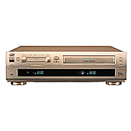
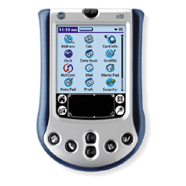
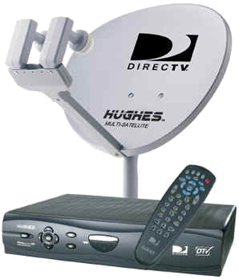
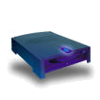
Typical FireWire configuration
Notes:
PC, video, cable + camcorder
Scanner, PDA, ?
Standardised wire length

Slide 5
FireWire initial configuration
R

Slide 6
FireWire Root Contention
Root
contention

Slide 7



FireWire Root Contention
Root
contention
Root
contention
R

Slide 8
FireWire – PRISM model
Based on probabilistic timed automata (PTA) model
  by Stoelinga et al. [SV99, SS01]
  infinite state (real-time)
  concurrency: messages between nodes and wires
  underspecification of delays (upper/lower bounds)
  probability: coin toss
Applied three PTA model checking approaches
  Symbolic forwards
  Symbolic backwards
  Digital clocks

Slide 9
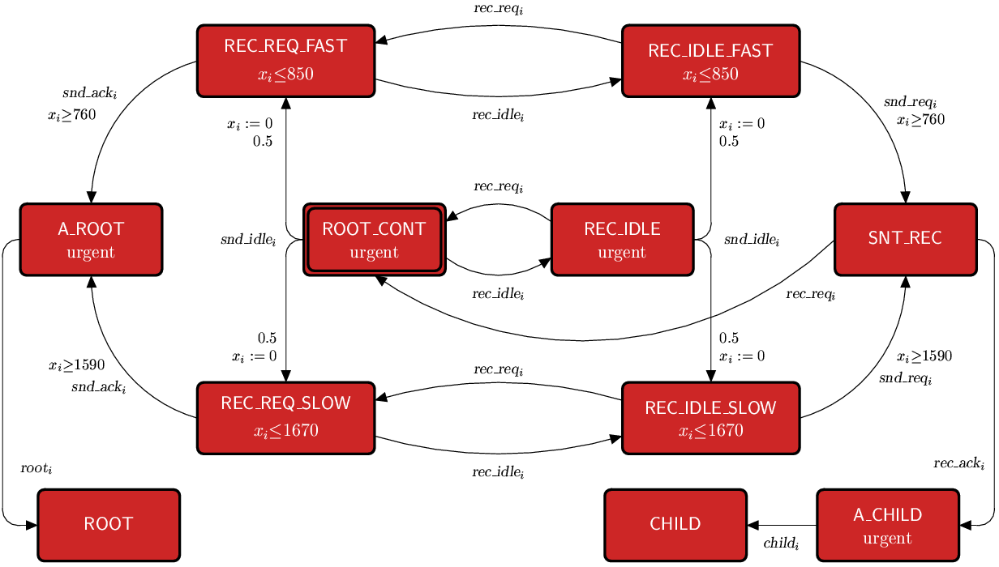
FireWire – PTA model of a node

Slide 10
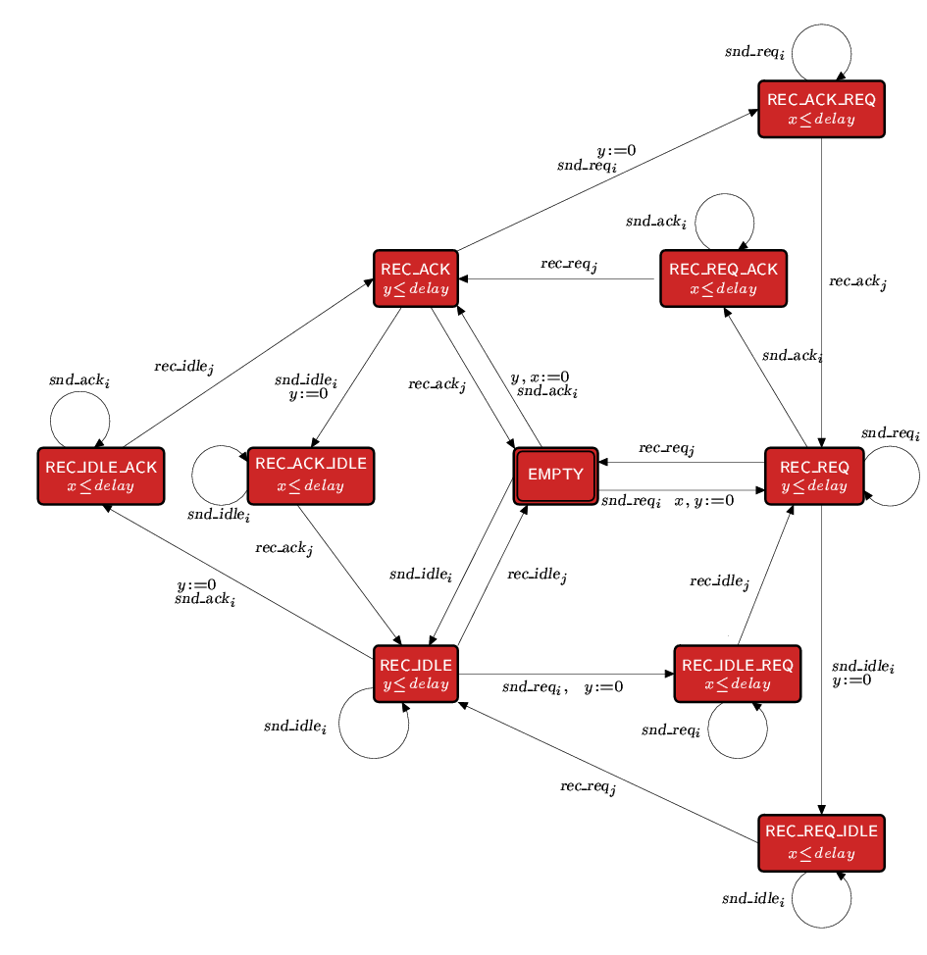
FireWire – PTA model of the wire

Slide 11
FireWire - Properties
Minimum probability that a leader is elected by time T
  z.Pmin_{=?} [ true U elected∧z≤T ]
  vary: T, coin bias: probability of choosing "fast“
Maximum expected time to elect a leader
  add reward structure for elapsed time
  assign reward one to each location
  Rmax_{=?} [ F elected ]
  vary: coin bias
  only the digital clocks is applicable

Slide 12
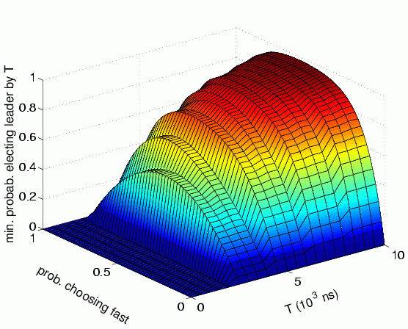
FireWire - Results
Minimum probability of electing leader by time T
  z.Pmin_{=?} [ true U elected∧z≤T ]

Slide 13
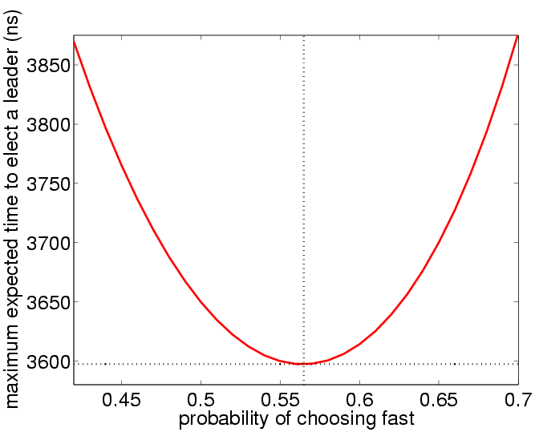
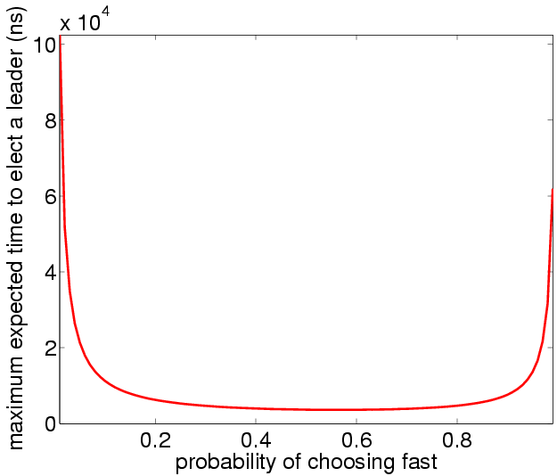
FireWire - Results
Maximum expected time to elect a leader
  Rmax_{=?} [ F elected ]
biased coin is beneficial

Slide 14
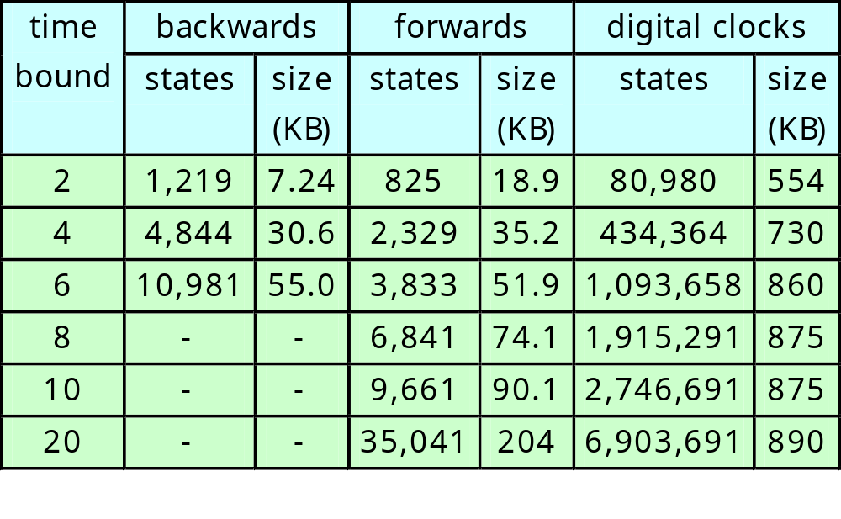
FireWire - Number of states

Slide 15
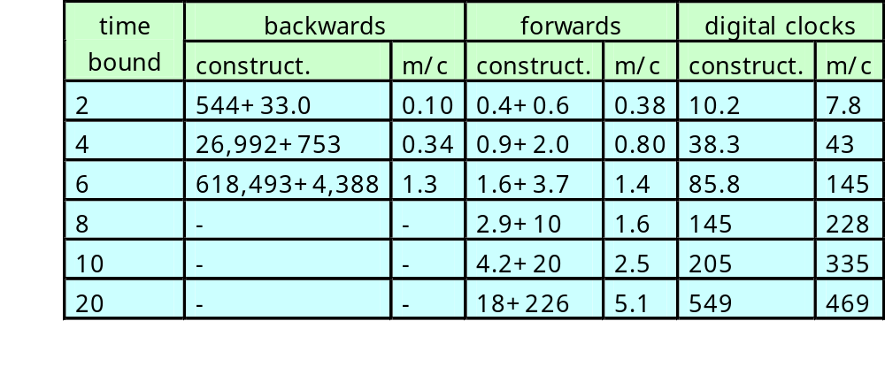
FireWire - Computation time

Slide 16
Experimental results: CSMA/CD
IEEE 802.3 CSMA/CD (Carrier Sense, Multiple Access with Collision Detection)
  model of [NSY92], without probabilities
  when a station has data to send, it listens to the medium
  if the medium was free (no one transmitting), the station starts to send its data
  if the medium was sensed busy, the station waits a random amount of time and then repeats this process
Exponential backoff scheme
  wait for a random delay between 0,...,2^{k}-1
  where k counts number of collisions up to a bound K

Slide 17
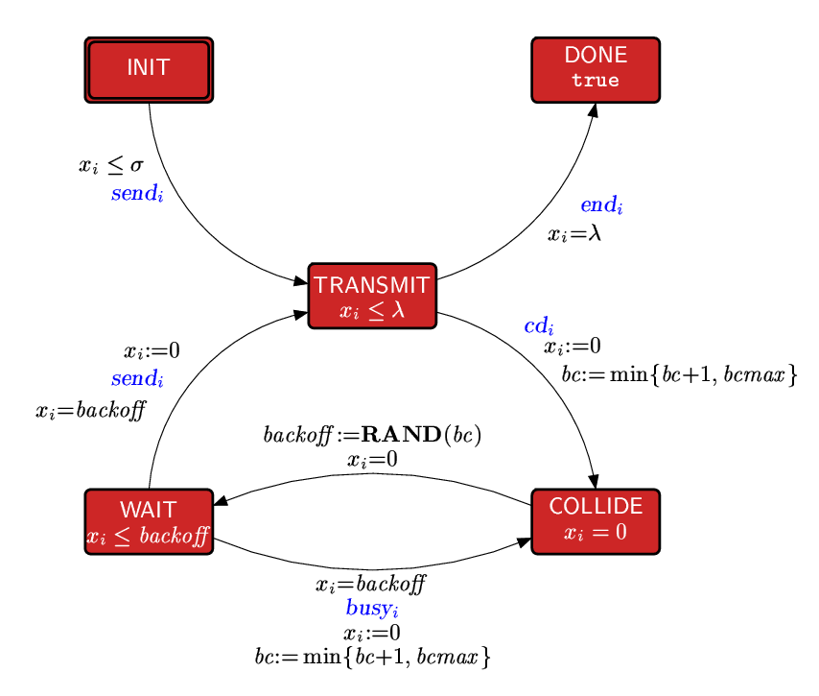
CSMA/CD – PTA model of a station

Slide 18
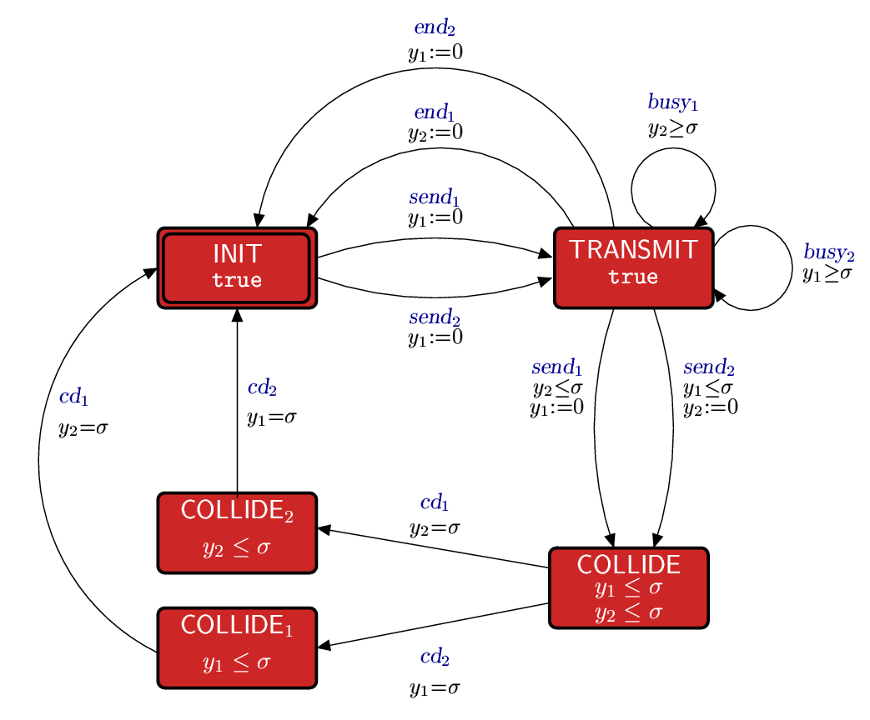
CSMA/CD – PTA model of the medium

Slide 19
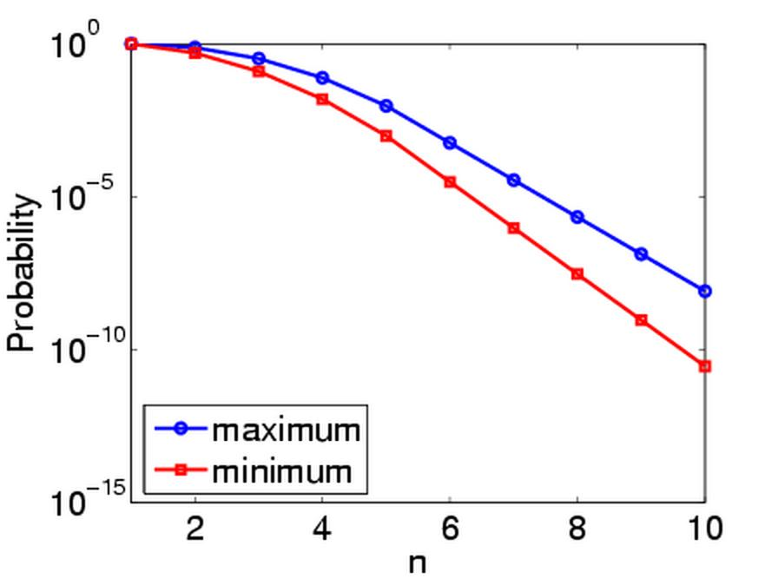
CSMA/CD -Results
Probability n collisions before a packet is sent (K=5)
  P_{=?} [ true U (collisions≥n ∧ unsent) ]

Slide 20
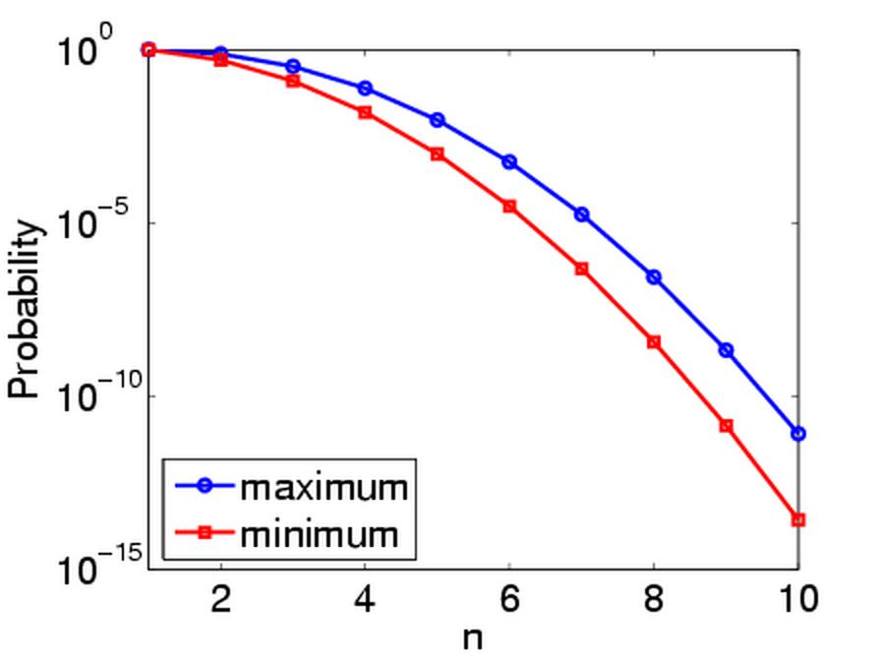
CSMA/CD -Results
Probability n collisions before a packet is sent (K=10)
  P_{=?} [ true U (collisions≥n ∧ unsent) ]

Slide 21
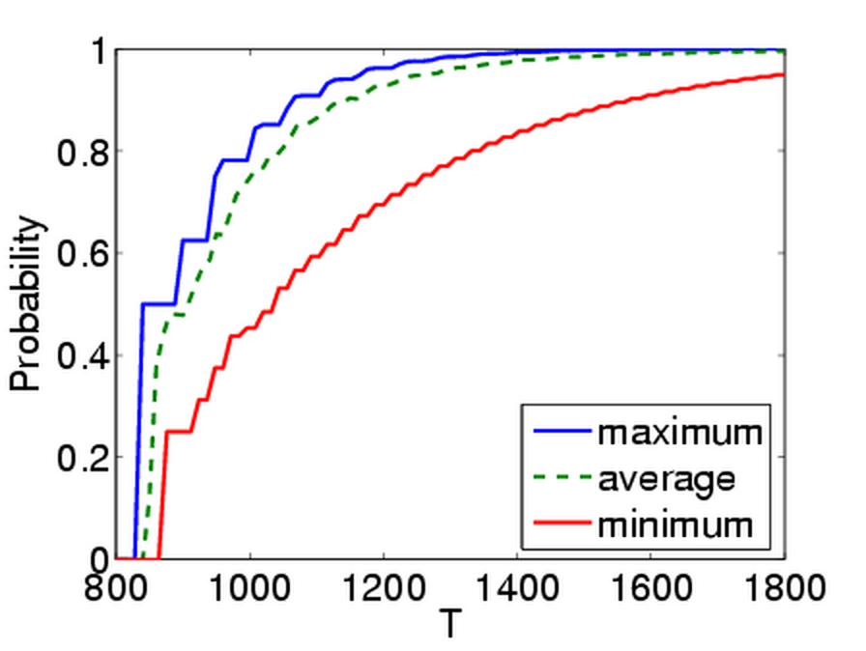
CSMA/CD -Results
Probability packet is sent before time T (K=5)
  z.P_{=?} [ true U (z≤T ∧ sent) ]

Slide 22
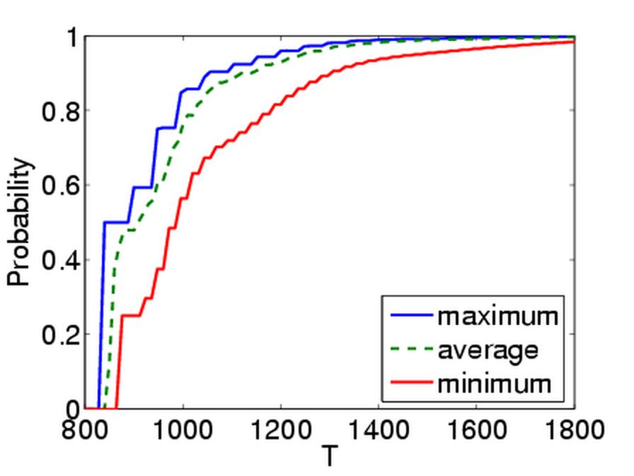
CSMA/CD -Results
Probability packet is sent before time T (K=10)
  z.P_{=?} [ true U (z≤T ∧ sent) ]

Slide 23
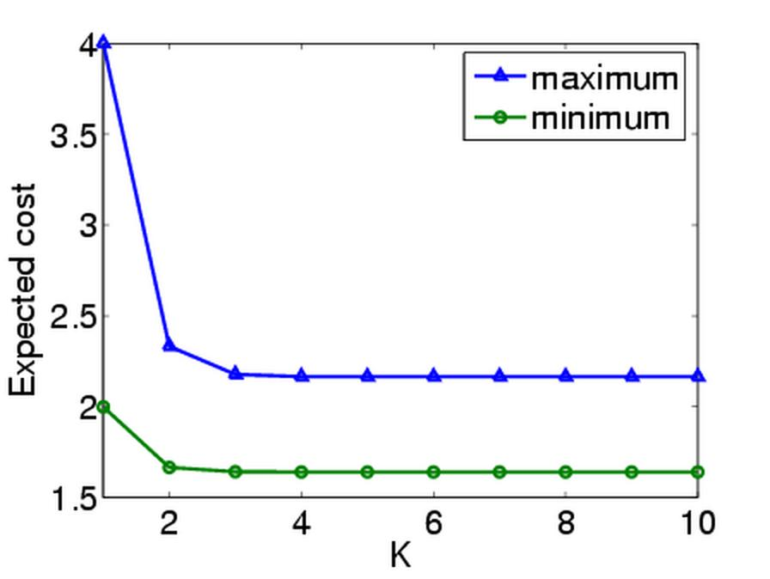
CSMA/CD -Results
Expected number of collisions before a packet is sent
  R_{=?} [ F sent ]

Slide 24
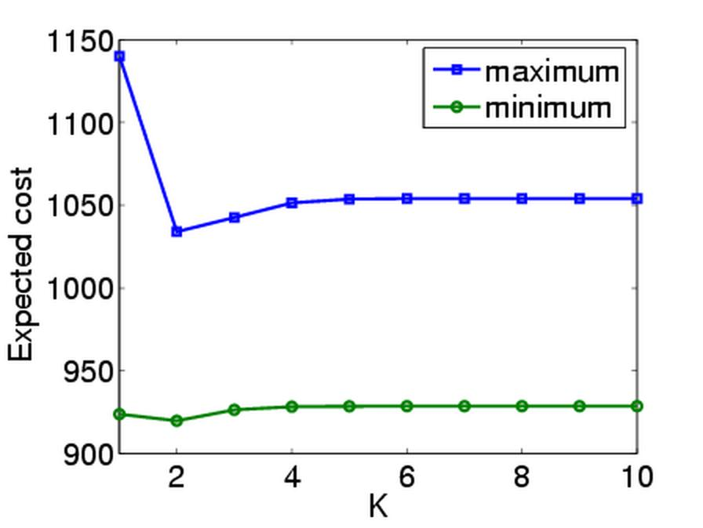
CSMA/CD -Results
Expected time until a packet is sent
  R_{=?} [ F sent ]

Slide 25
Summing up…
What have we achieved?
Probabilistic timed automata
  appropriate model for distributed coordination protocols that use randomisation
Developed a methodology for quantitative analysis and verification
  theory of probabilistic model checking: symbolic, digital clocks, sampling-based
  resource usage and expectations
  implementation of the techniques and experimental results

Slide 26
Further information
More on FireWire root contention
  see [KNS03b,KNPS06,KNSW07]
More on CSMA/CD
  see [DKN+06]
More on similar protocols
  802.11 WiFi [KNS03b]
  IPv4 Zeroconf [KNS03b]
  802.15.4 Zigbee [Fru06]
More information, see the PRISM web page
  www.prismmodelchecker.org

